Slide 1
The 8051 Microcontroller and Embedded Systems
CHAPTER 10
8051 SERIAL PORT PROGRAMMING IN ASSEMBLY
vignan university

Slide 2
OBJECTIVES
Contrast and compare serial versus parallel communication
List the advantages of serial communication over parallel
Explain serial communication protocol
Contrast synchronous versus asynchronous communication
Contrast half-versus full-duplex transmission
Explain the process of data framing
Describe data transfer rate and bps rate
Define the RS232 standard
Explain the use of the MAX232 and MAX233 chips
vignan university

Slide 3
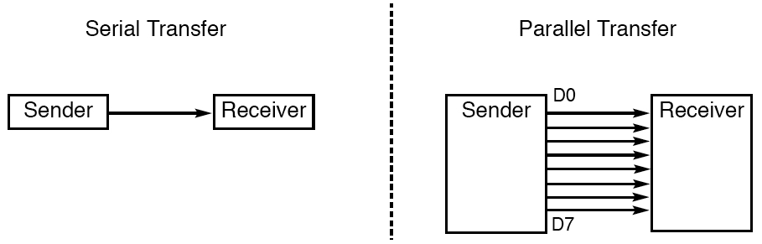
SECTION 10.1: BASICS OF SERIAL COMMUNICATION
Figure 10–1 Serial versus Parallel Data Transfer
vignan university

Slide 4
SECTION 10.1: BASICS OF SERIAL COMMUNICATION
serial communication uses single data line making it much cheaper
enables two computers in different cities to communicate over the telephone
byte of data must be converted to serial bits using a parallel-in-serial-out shift register and transmitted over a single data line
receiving end there must be a serial-in-parallel-out shift register
if transferred on the telephone line, it must be converted to audio tones by modem
for short distance the signal can be transferred using wire
how PC keyboards transfer data to the motherboard
vignan university

Slide 5
SECTION 10.1: BASICS OF SERIAL COMMUNICATION
2 methods, asynchronous and synchronous
synchronous method transfers a block of data (characters) at a time
asynchronous method transfers a single byte at a time
Uses special IC chips called UART (universal asynchronous receiver-transmitter) and USART (universal synchronous­asynchronous receiver-transmitter)
8051 chip has a built-in UART
vignan university

Slide 6
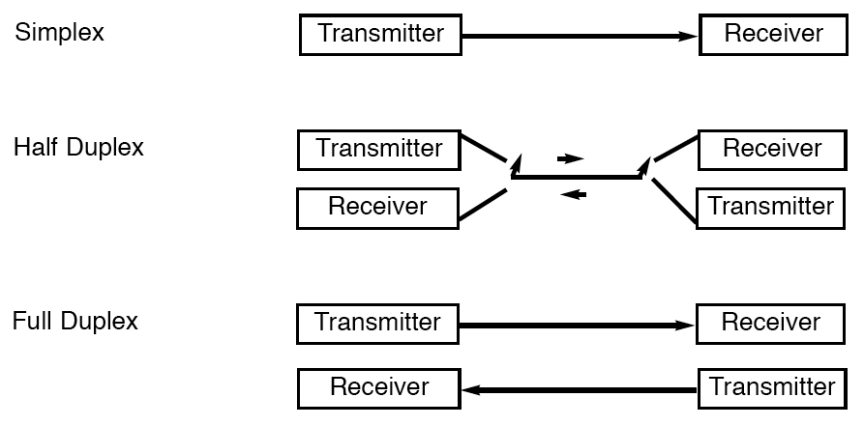
SECTION 10.1: BASICS OF SERIAL COMMUNICATION
Figure 10–2 Simplex, Half-, and Full-Duplex Transfers
vignan university

Slide 7
SECTION 10.1: BASICS OF SERIAL COMMUNICATION
Half- and full-duplex transmission
  if the data can be transmitted and received, it is a duplex transmission
  simplex transmissions the computer only sends data
  duplex transmissions can be half or full duplex
  depends on whether or not the data transfer can be simultaneous
  If one way at a time, it is half duplex
  If can go both ways at the same time, it is full duplex
  full duplex requires two wire conductors for the data lines (in addition to the signal ground)
vignan university

Slide 8
SECTION 10.1: BASICS OF SERIAL COMMUNICATION
Asynchronous serial communication and data framing
  data coming in 0s and 1s
  to make sense of the data sender and receiver agree on a set of rules
  Protocol
    how the data is packed
    how many bits/character
    when the data begins and ends
vignan university

Slide 9
SECTION 10.1: BASICS OF SERIAL COMMUNICATION
Start and stop bits
  asynchronous method, each character is placed between start and stop bits
  called framing
  start bit is always one bit
  stop bit can be one or two bits
  start bit is always a 0 (low)
  stop bit(s) is 1 (high)
  LSB is sent out first
vignan university

Slide 10
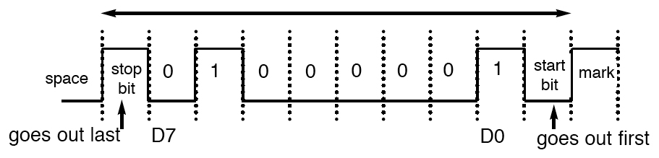
SECTION 10.1: BASICS OF SERIAL COMMUNICATION
Figure 10–3 Framing ASCII “A” (41H)
vignan university

Slide 11
SECTION 10.1: BASICS OF SERIAL COMMUNICATION
in modern PCs one stop bit is standard
when transferring a text file of ASCII characters using 1 stop bit there is total of 10 bits for each character
8 bits for the ASCII code (1 parity bit), 1 bit each for the start and stop bits
for each 8-bit character there are an extra 2 bits, which gives 20% overhead
vignan university

Slide 12
SECTION 10.1: BASICS OF SERIAL COMMUNICATION
Data transfer rate
  rate of data transfer bps (bits per second)
  widely used terminology for bps is baud rate
  baud and bps rates are not necessarily equal
  baud rate is defined as the number of signal changes per second
vignan university

Slide 13
SECTION 10.1: BASICS OF SERIAL COMMUNICATION
RS232 standards
  most widely used serial I/O interfacing standard
  input and output voltage levels are not TTL compatible
  1 bit is represented by -3 to -25 V
  0 bit is +3 to +25 V
  -3 to +3 is undefined
  to connect RS232 to a microcontroller system must use voltage converters such as MAX232 to convert the TTL logic levels to the RS232 voltage levels, and vice versa
  MAX232 IC chips are commonly referred to as line drivers
vignan university

Slide 14
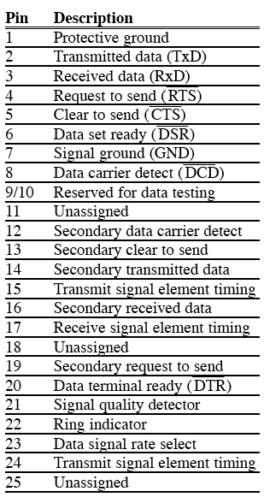
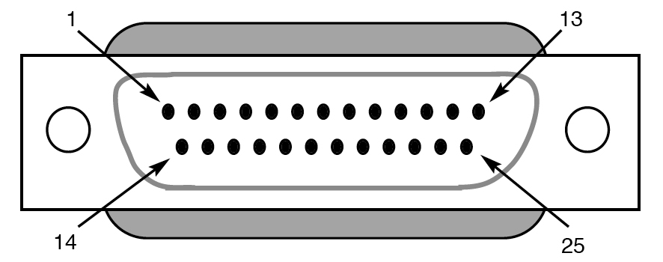
SECTION 10.1: BASICS OF SERIAL COMMUNICATION
Figure 10–4 RS232 Connector DB-25
Table 10–1 RS232 Pins (DB-25)
vignan university

Slide 15
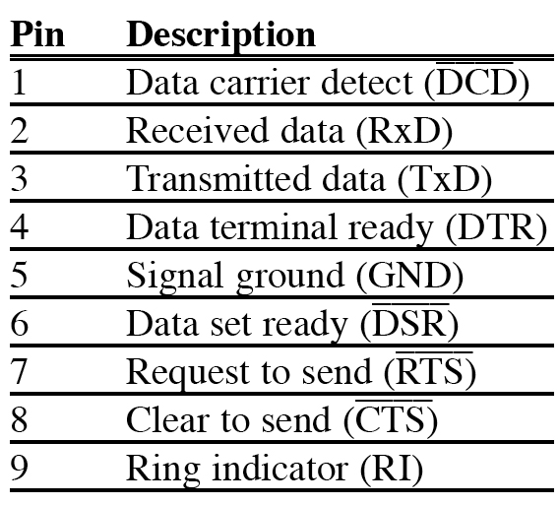
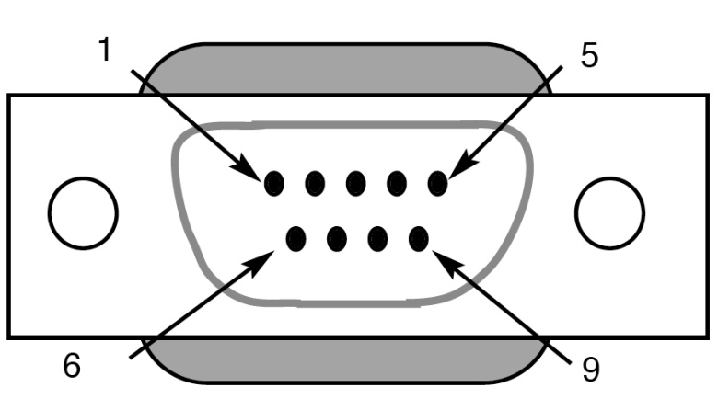
SECTION 10.1: BASICS OF SERIAL COMMUNICATION
Figure 10–5 DB-9 9-Pin Connector
Table 10–2 IBM PC DB-9 Signals
vignan university

Slide 16
SECTION 10.1: BASICS OF SERIAL COMMUNICATION
Data communication classification
  DTE (data terminal equipment)
  DCE (data communication equipment)
  DTE - terminals and computers that send and receive data
  DCE - communication equipment responsible for transferring the data
  simplest connection between a PC and microcontroller requires a minimum of three pins, TxD, RxD, and ground
vignan university

Slide 17
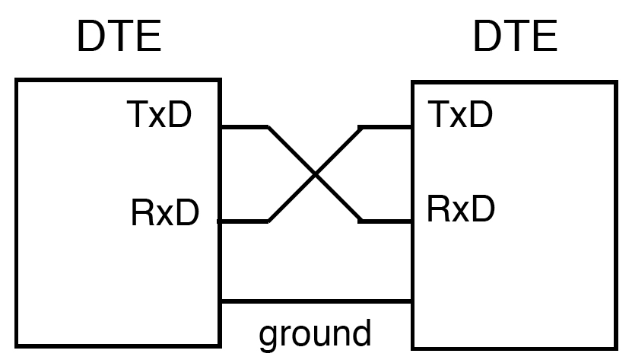
SECTION 10.1: BASICS OF SERIAL COMMUNICATION
Figure 10–6 Null Modem Connection
vignan university

Slide 18
SECTION 10.1: BASICS OF SERIAL COMMUNICATION
Examining RS232 hand­shaking signals
  many of the pins of the RS-232 connector are used for handshaking signals
  they are not supported by the 8051 UART chip
vignan university

Slide 19
SECTION 10.1: BASICS OF SERIAL COMMUNICATION
PC/compatible COM ports
  PC/compatible computers (Pentium) microprocessors normally have two COM ports
  both ports have RS232-type connectors
  COM ports are designated as COM 1 and COM 2 (replaced by USB ports)
  can connect the 8051 serial port to the COM 2 port
vignan university

Slide 20
SECTION 10.2: 8051 CONNECTION TO RS232
RxD and TxD pins in the 8051
  8051 has two pins used for transferring and receiving data serially
  TxD and RxD are part of the port 3 group
  pin 11 (P3.1) is assigned to TxD
  pin 10 (P3.0) is designated as RxD
  these pins are TTL compatible
  require a line driver to make them RS232 compatible
  driver is the MAX232 chip
vignan university

Slide 21
SECTION 10.2: 8051 CONNECTION TO RS232
MAX232
  converts from RS232 voltage levels to TTL voltage levels
  uses a +5 V power source
  MAX232 has two sets of line drivers for transferring and receiving data
  line drivers used for TxD are called T1 and T2
  line drivers for RxD are designated as R1 and R2
  T1 and R1 are used together for TxD and RxD of the 8051
  second set is left unused
vignan university

Slide 22
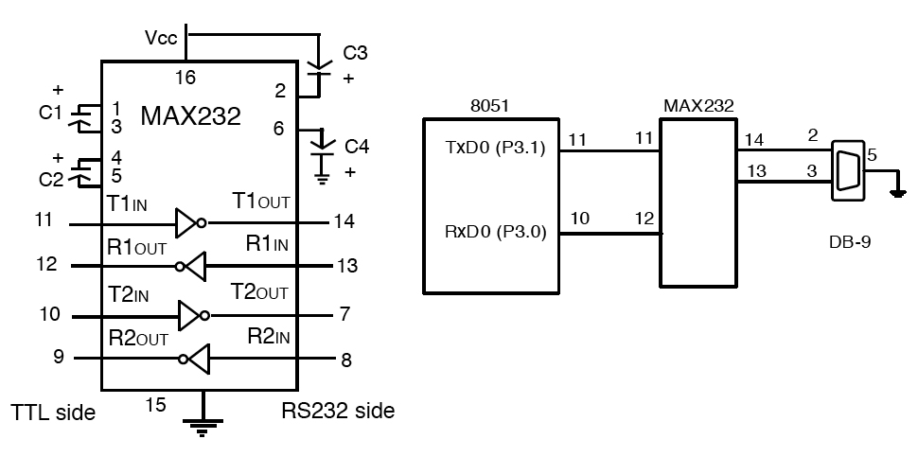
SECTION 10.2: 8051 CONNECTION TO RS232
Figure 10–7 (a) Inside MAX232
(b) its Connection to the 8051 (Null Modem)
vignan university

Slide 23
SECTION 10.2: 8051 CONNECTION TO RS232
MAX233
  MAX233 performs the same job as the MAX232
  eliminates the need for capacitors
  much more expensive than the MAX232
vignan university

Slide 24
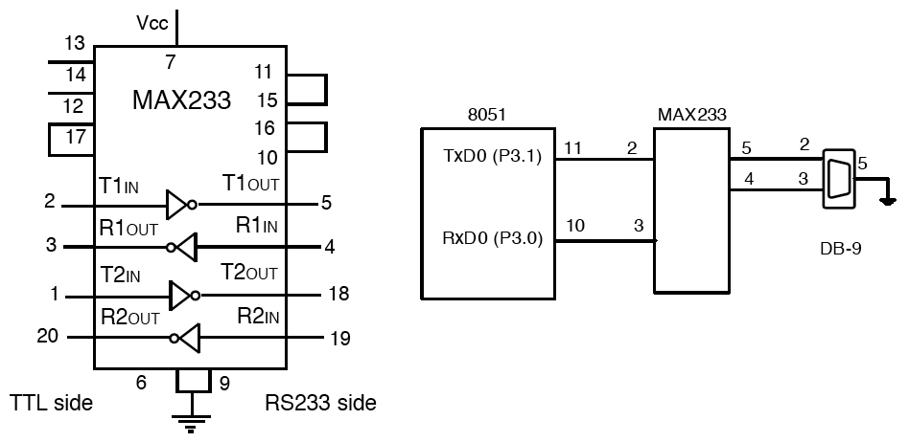
SECTION 10.2: 8051 CONNECTION TO RS232
Figure 10–8 (a) Inside MAX233
(b) Its Connection to the 8051 (Null Modem)
vignan university

Slide 25
SECTION 10.3: 8051 SERIAL PORT PROGRAMMING IN ASSEMBLY
Baud rate in the 8051
  serial communications of the 8051 with the COM port of the PC
  must make sure that the baud rate of the 8051 system matches the baud rate of the PC's COM port
  can use Windows HyperTerminal program
vignan university

Slide 26
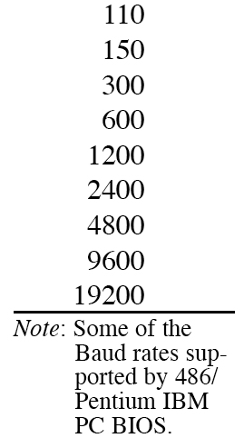
SECTION 10.3: 8051 SERIAL PORT PROGRAMMING IN ASSEMBLY
Table 10–3 PC Baud Rates
vignan university

Slide 27
SECTION 10.3: 8051 SERIAL PORT PROGRAMMING IN ASSEMBLY
Baud rate in the 8051
  baud rate in the 8051 is programmable
  done with the help of Timer 1
  relationship between the crystal frequency and the baud rate in the 8051
  8051 divides the crystal frequency by 12 to get the machine cycle frequency
  XTAL = 11.0592 MHz, the machine cycle frequency is 921.6 kHz
  8051's UART divides the machine cycle frequency of 921.6 kHz by 32 once more before it is used by Timer 1 to set the baud rate
  921.6 kHz divided by 32 gives 28,800 Hz
  Timer 1 must be programmed in mode 2, that is 8-bit, auto-reload
vignan university

Slide 28
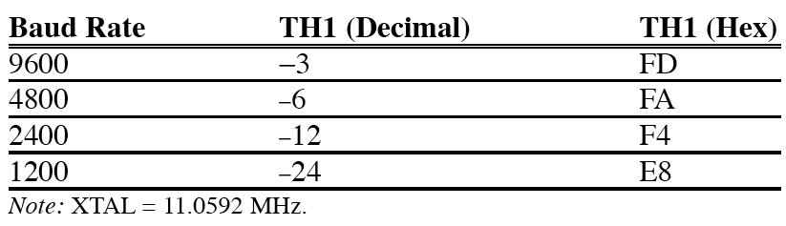
SECTION 10.3: 8051 SERIAL PORT PROGRAMMING IN ASSEMBLY
Table 10–4 Timer 1 TH1 Register Values for Various Baud Rates
vignan university

Slide 29
Example 10-1
With XTAL = 11.0592 MHz, find the TH1 value needed to have the following baud rates. (a) 9600 (b) 2400 (c) 1200
machine cycle frequency
  = 11.0592 MHz / 12 = 921.6 kHz
Timer 1 frequency provided by 8051 UART
  = 921.6 kHz / 32 = 28,800 Hz
(a) 28,800 / 3 = 9600 where -3 = FD (hex)
(b) 28,800 / 12 = 2400 where -12 = F4 (hex)
(c) 28,800 / 24 = 1200 where -24 = E8 (hex)
vignan university

Slide 30
SECTION 10.3: 8051 SERIAL PORT PROGRAMMING IN ASSEMBLY
11.0592 MHz XTAL oscillator
vignan university

Slide 31
SECTION 10.3: 8051 SERIAL PORT PROGRAMMING IN ASSEMBLY
SBUF (serial buffer) register
    a byte of data to be transferred via the TxD line must be placed in the SBUF register
    SBUF holds the byte of data when it is received by the RxD line
    can be accessed like any other register
      MOV SBUF,#'D' ;load SBUF=44H, ASCII for 'D‘
      MOV SBUF,A ;copy accumulator into SBUF
      MOV A,SBUF ;copy SBUF into accumulator
    when a byte is written, it is framed with the start and stop bits and transferred serially via the TxD pin
    when the bits are received serially via RxD, it is deframe by eliminating the stop and start bits, making a byte out of the data received, and then placing it in the SBUF
vignan university

Slide 32
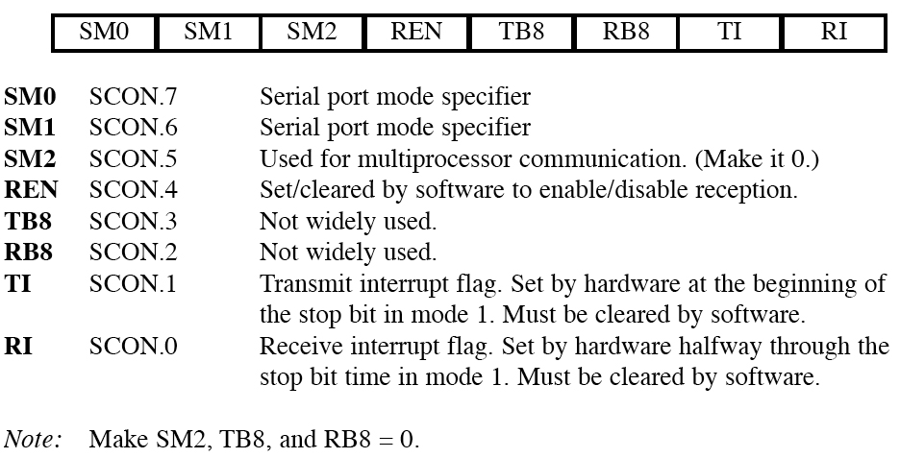
SECTION 10.3: 8051 SERIAL PORT PROGRAMMING IN ASSEMBLY
SCON (serial control) register
  to program the start bit, stop bit, and data bits
vignan university
Figure 10–9 SCON Serial Port Control Register (Bit-Addressable)

Slide 33
SECTION 10.3: 8051 SERIAL PORT PROGRAMMING IN ASSEMBLY
SM0 and SM1 determine the mode
only mode 1 is important
when mode 1 is chosen, the data framing is 8 bits, 1 stop bit, and 1 start bit
compatible with the COM port of PCs
mode 1 allows the baud rate to be variable and is set by Timer 1 of the 8051
for each character a total of 10 bits are transferred, where the first bit is the start bit, followed by 8 bits of data, and finally 1 stop bit.
vignan university

Slide 34
SECTION 10.3: 8051 SERIAL PORT PROGRAMMING IN ASSEMBLY
REN (receive enable)
REN=1, allows 8051 to receive data on the RxD
if 8051 is to both transfer and receive data, REN must be set to 1
REN=0, the receiver is disabled
SETB SCON.4 and CLR SCON.4,
vignan university

Slide 35
SECTION 10.3: 8051 SERIAL PORT PROGRAMMING IN ASSEMBLY
TI (transmit interrupt)
  when 8051 finishes the transfer of the 8-bit character, it raises the TI flag to indicate that it is ready to transfer another byte
RI (receive interrupt)
  when the 8051 receives data serially via RxD, it places the byte in the SBUF register
  then raises the RI flag bit to indicate that a byte has been received and should be picked up before it is lost
vignan university

Slide 36
SECTION 10.3: 8051 SERIAL PORT PROGRAMMING IN ASSEMBLY
Program to transfer data serially
  TMOD register is loaded with the value 20H
  TH1 is loaded with value to set the baud rate
  SCON register is loaded with the value 50H
  TR1 is set to 1 to start Timer1
  TI is cleared by the "CLR TI" instruction
  transmit character byte is written into the SBUF register
  TI flag bit is monitored to see if the character has been transferred completely
  to transfer the next character, go to Step 5.
vignan university

Slide 37
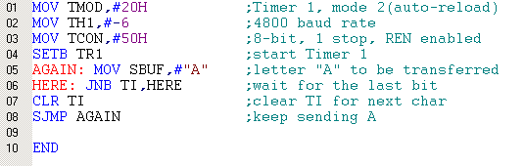
Example 10-2
Write a program to transfer letter "A" serially at 4800 baud, continuously. (Error in line 3 – should be SCON)
vignan university

Slide 38
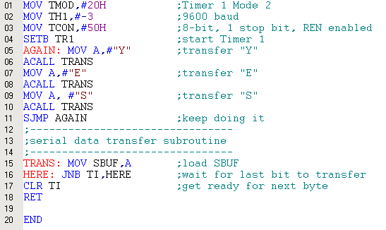
Example 10-3
Write a program to transfer the message "YES" serially at 9600 baud, 8-bit data, 1 stop bit. Do this continuously.
(Error in line 3 – should be SCON)
vignan university

Slide 39
SECTION 10.3: 8051 SERIAL PORT PROGRAMMING IN ASSEMBLY
Importance of the TI flag
  check the TI flag bit, we know whether can transfer another byte
  TI flag bit is raised by the 8051
  TI flag cleared by the programmer
  writing a byte into SBUF before the TI flag bit is raised, may lead to loss of a portion of the byte being transferred
vignan university

Slide 40
SECTION 10.3: 8051 SERIAL PORT PROGRAMMING IN ASSEMBLY
Program to receive data serially
  TMOD register is loaded with the value 20H
  TH1 is loaded with value set the baud rate
  SCON register is loaded with the value 50H
  TR1 is set to 1 to start Timer 1
  RI is cleared with the "CLR RI" instruction
  RI flag bit is monitored to see if an entire character has been received yet
  RI=1 SBUF has the byte, its contents are moved into a safe place
  to receive the next character, go to Step 5
vignan university

Slide 41
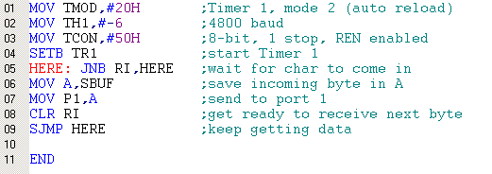
Example 10-4
Program the 8051 to receive bytes of data serially, and put them in P1. Set the baud rate at 4800, 8-bit data, and 1 stop bit.
(Error in line 3 – should be SCON)
vignan university

Slide 42
SECTION 10.3: 8051 SERIAL PORT PROGRAMMING IN ASSEMBLY
Importance of the RI flag bit
  it receives the start bit, next bit is the first bit of the character
  when the last bit is received, a byte is formed and placed in SBUF
  when stop bit is received, makes RI = 1
  when RI=1, received byte is in the SBUF register, copy SBUF contents to a safe place
  after the SBUF contents are copied the RI flag bit must be cleared to 0
vignan university

Slide 43

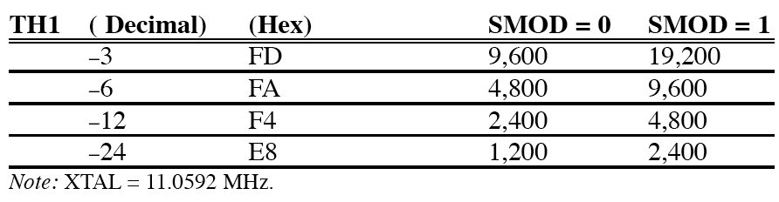
SECTION 10.3: 8051 SERIAL PORT PROGRAMMING IN ASSEMBLY
Doubling the baud rate in the 8051
  two ways to increase the baud rate
    Use a higher-frequency crystal
    Change a bit in the PCON register
vignan university
Table 10–5 Baud Rate Comparison for SMOD = 0 and SMOD = 1

Slide 44
SECTION 10.3: 8051 SERIAL PORT PROGRAMMING IN ASSEMBLY
Interrupt-based data transfer
  it is a waste of the microcontroller's time to poll the TI and RI flags
  to avoid wasting time, use interrupts instead of polling
vignan university

Slide 45
Next …
Lecture Problems Textbook Chapter 10
  Answer as many questions as you can and submit via MeL before the end of the lecture.
Proteus Exercise 9
  Do as much of the Proteus exercise as you can and submit via MeL before the end of the lecture.
vignan university

